Slide 1

INC300
Week 8
Community: Internet Cultures
Amanda Piche, PhD Candidate
July 12th, 2018
Notes:
During Part 1: Social Networks, we explored how social media participation allows communities to form online. The social phenomena of “homophily” - that “like attracts like” or “birds of a feather flock together”.
Part 2: Internet Cultures we will explore the parts of social media that assist with community creation by looking at how social media can facilitate people from all over the world to come together because of a shared interest or hobby.

Slide 2
Today’s Agenda
Check-in
Lecture
Launch next assignment: Social Media Transformation

Slide 3
Lecture 8: Community – Internet Cultures
Learning Outcomes:
Describe the connections between dialogic communication and participatory culture.
Use the concepts of homophily and affinity groups to explain the formation of communities via social media and explain how LOLCats are an example of such.
Describe how the making and sharing of Internet memes can lead to connection, interaction and participation in particular communities.
Describe what is involved in making content ‘go viral'

Slide 4
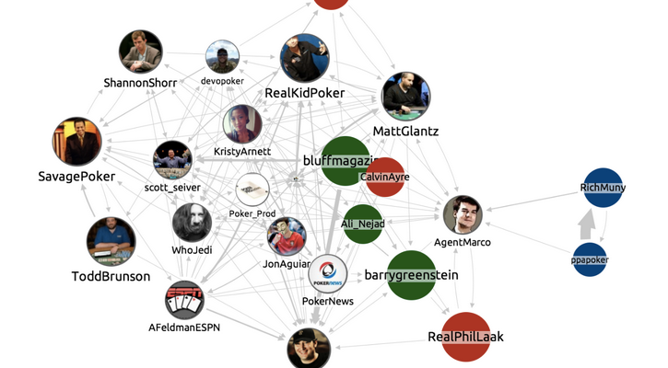
Week 7 and Mini-Lesson #2 Recap
What research involving a social network analysis might look like and an example of research conducted by Facebook (the newsfeed manipulation study).
The concepts of the filter bubble and homophily, and how they are related to the variety and diversity of information you might see in your social networking newsfeeds.
The migration of users between social networking sites and how our personal networks may blind us to how other users interact with sites that we no longer participate in.
The definitions of being a “celebrity” and being “famous”.
How viral media has made it possible for unlikely or unexpected people to become famous, as was the case of Zeddie Little and Blake Boston.
The ways that celebrity can be monetized via social networking sites, via sponsored content and allowing Google AdSense to serve advertisements to your audience.
The Secret Lives of Tumblr Teens served as example of how much money can be made via Google AdSense, but attempts to scam the system will eventually be discovered and shut down

Slide 5
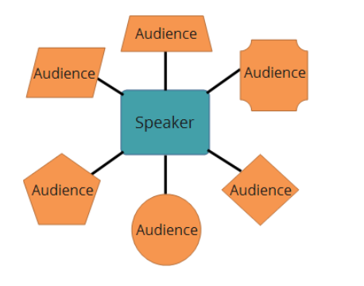
Review: Monologic vs. Dialogic Transmission
Our course began with a discussion about the differences between monologic and dialogic communication. To review the definitions of and the differences between two terms:
Monologic transmission is one-way communication. There is a single source or creation point, and then the message is relayed to multiple receivers. Everyone receiving the message gets the same information, there is no individual customization of the message they are hearing, reading, or seeing. An example of monologic transmission would be listening to a radio broadcast or watching a live event being broadcast on television. Everyone tuning in from their home devices (radio, TV, etc.) will hear and/or see the same message.

Slide 6
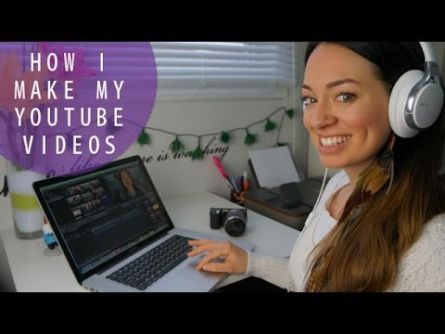
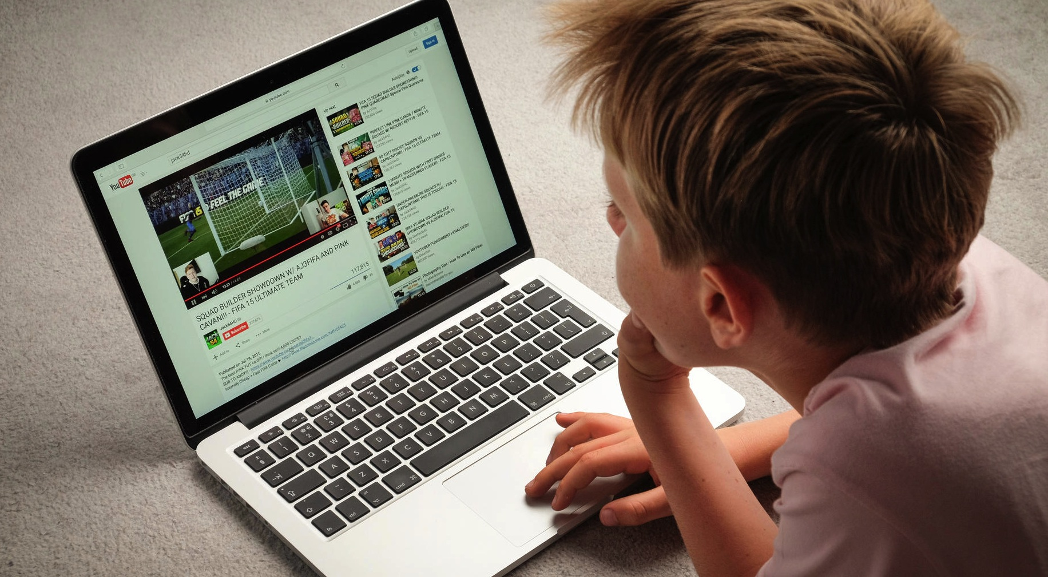
Review: Monologic vs. Dialogic Transmission
In contrast to radio or television, social media is a form of dialogic transmission. By participating in social media today you become part of the conversation. Rather than only listening to the message, you become both the audience and the speaker. Due to the conversational nature of social media it is also sometimes referred to as participatory media.
In this lecture we will explore participatory media and how it encourages groups to come together through a shared interest.

Slide 7

Participatory Culture
Henry Jenkins, a media scholar, has spent considerable time investigating and theorizing the new forms of self-expression that have been made possible with advances to interactive technologies. Previously, we would talk about media being consumed because all members of the audience would receive the same broadcast with no customization.
Notes:
Link in photo: https://www.youtube.com/watch?v=1gPm-c1wRsQ

Slide 8
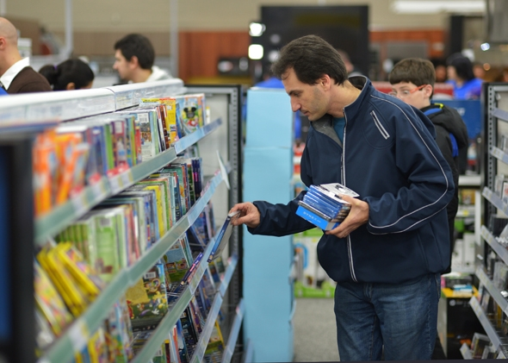
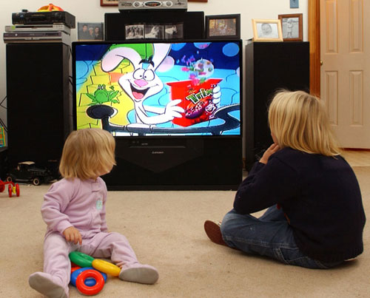
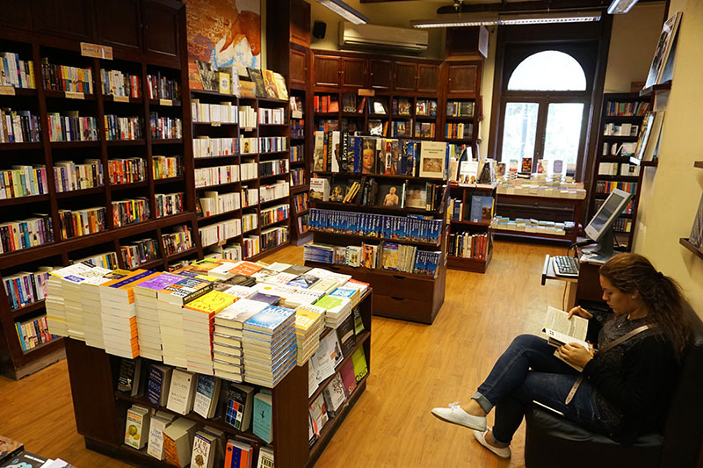
Participatory Culture
The word choice of "consumed" is intentional. Just like other elements of consumer culture where fully manufactured goods are purchased rather than made by individuals, this media comes to its audience in its completed form. Media creation in this instance is predominately intended for making profit either by selling the media to consumers directly and/or selling advertising space to interested parties.

Slide 9
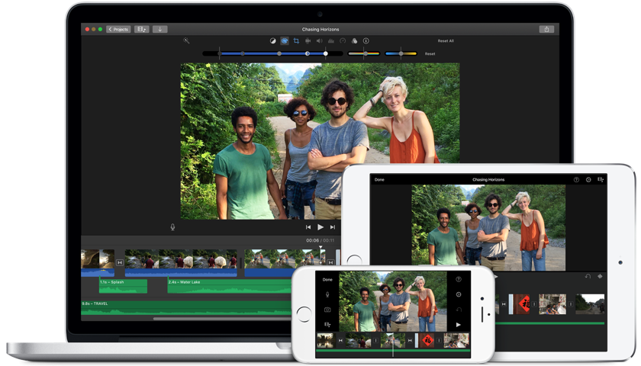
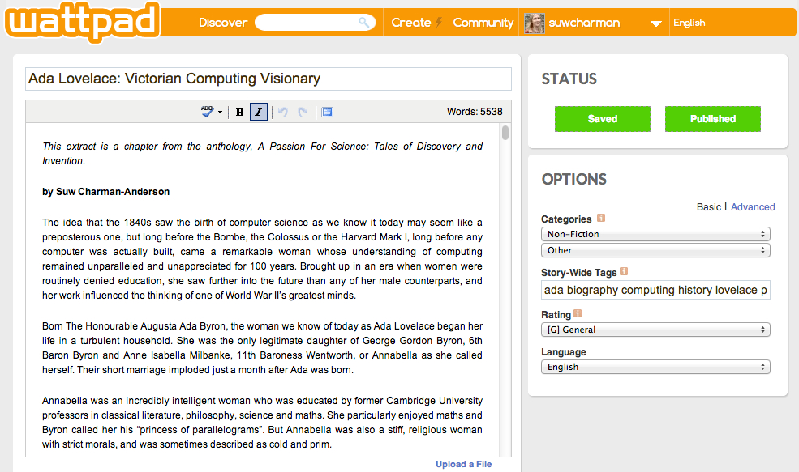
Participatory Culture
The proliferation of inexpensive, widely available tools (e.g. digital cameras, video editing software that can be used on a home computer), increased availability of Internet access, and the ability to post your own content to websites (as described previously when we looked at Web 2.0 in Lecture 1) has led to an increased number of possibilities to share your own stories that may not be reflected in mainstream, commercial media. Here the boundary between producer and consumer has become blurred.

Slide 10
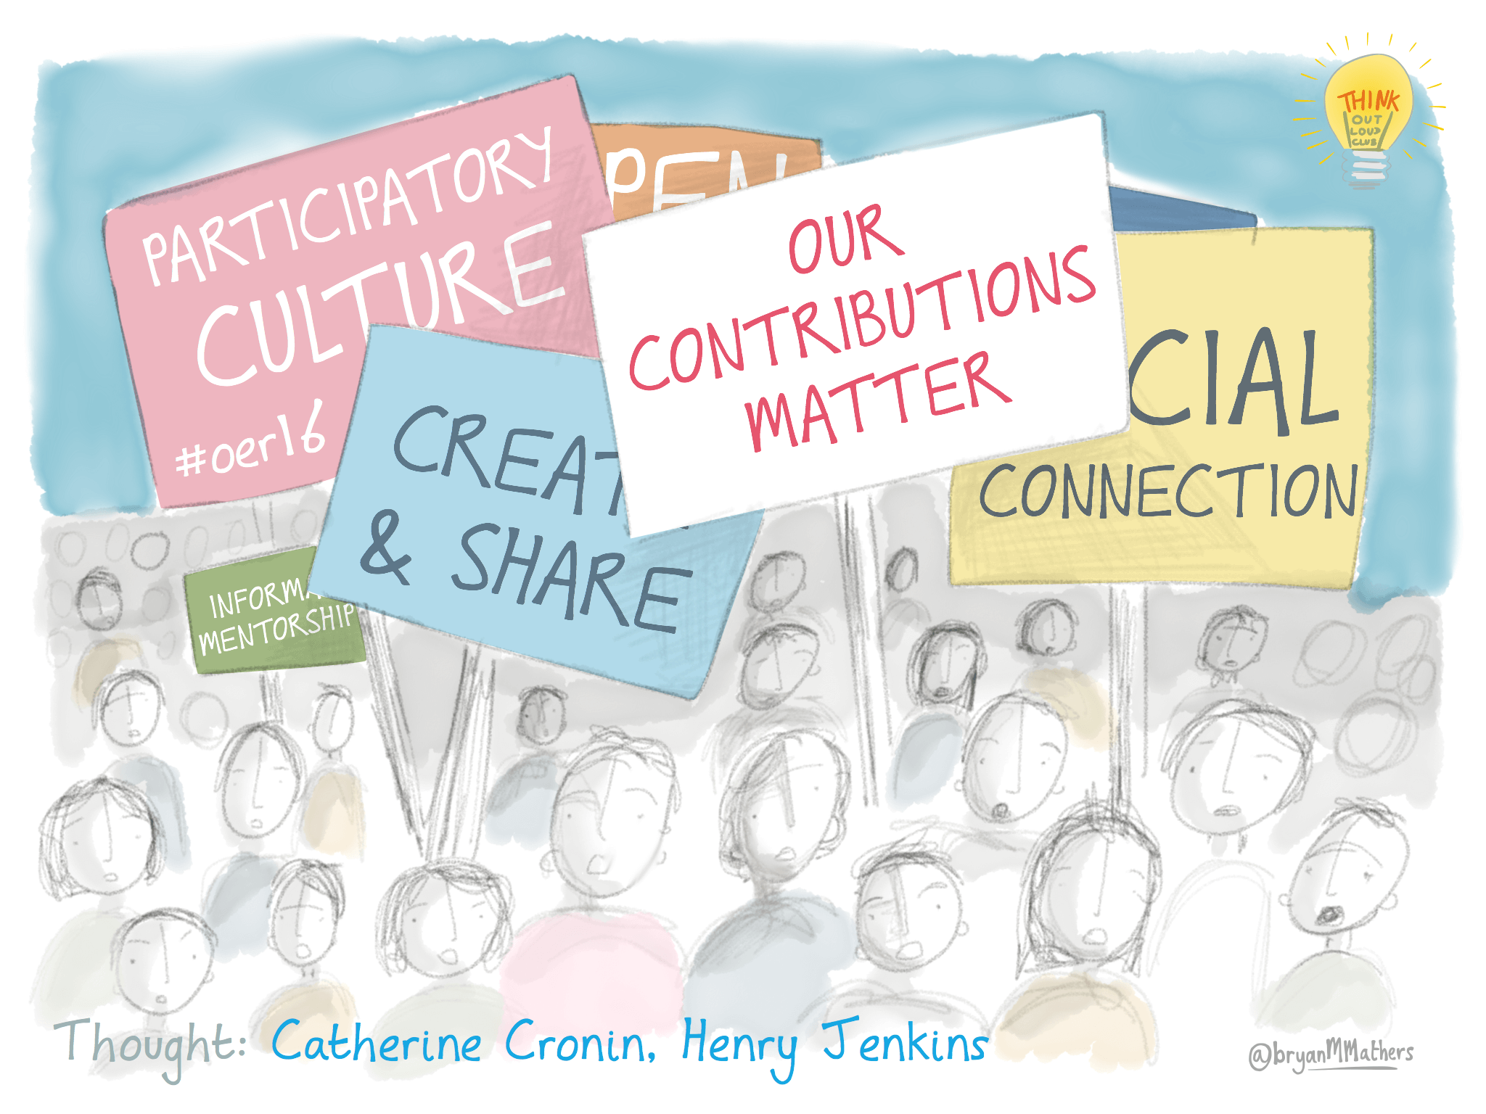
Participatory Culture
Participatory media has in turn lead to participatory culture. Participatory culture has five distinguishing characteristics:
Low barrier to entry: You do not need an expensive piece of equipment or access to the latest computer software. The tools you need to participate are low cost (or free). Much like the third places we discussed in “Context Collapse”, there are no expensive membership fees or rules limiting who can join the group.
Support structures: The community of creators exhibits strong support for creating and sharing one’s creations with the rest of the group.
Mentorship: Informal mentorship exists where knowledge is passed from more experienced group members to novices/newcomers.
What you make matters: Members believe their contributions to the group will be welcomed and respected by other community members.
Community matters: Members feel a degree of social connection with each other & care about what other community members think about their creations.

Slide 11

Example: YouTube as a website of Participatory Culture
Low barrier to entry: You do not need an expensive piece of equipment or access to the latest computer software. The tools you need to participate are low cost (or free).
It is free to upload content to YouTube.
Do need a way to record and edit content, but these tools are easily accessible (i.e. our phones, computers, or even using tools from library, college)
Editing software can vary in price but can be free. The type of software that you use doesn't really make a difference. This means that you can use Final Cut Pro 7 or X, Adobe Premiere Pro, Avid, Sony Vegas, iMovie, Windows Movie Maker, Youtube's editing software or don't even edit.
Can access Creative Commons content for free media to include in videos
Notes:
Link in the second photo: https://www.edutopia.org/video/henry-jenkins-participatory-culture-and-media-education-big-thinkers-series

Slide 12
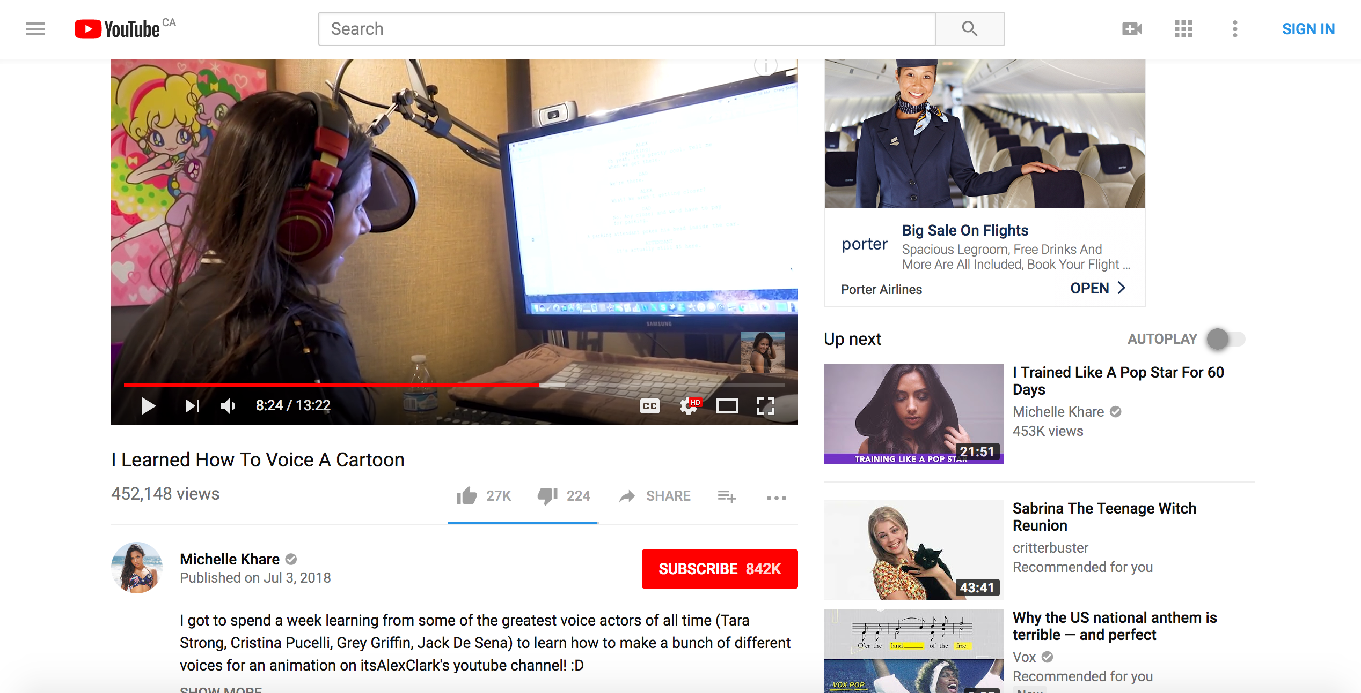
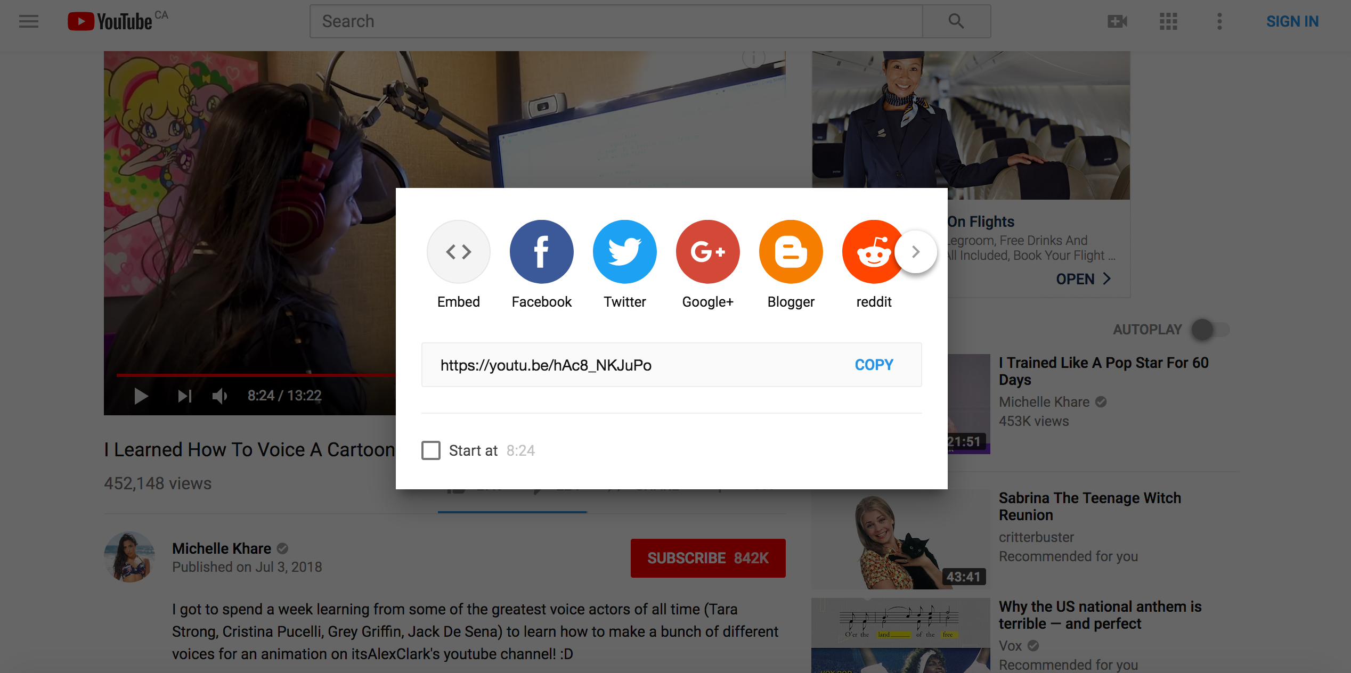
Example: YouTube as a website of Participatory Culture
Support structures: The community of creators exhibits strong support for creating and sharing one’s creations with the rest of the group.

Slide 13

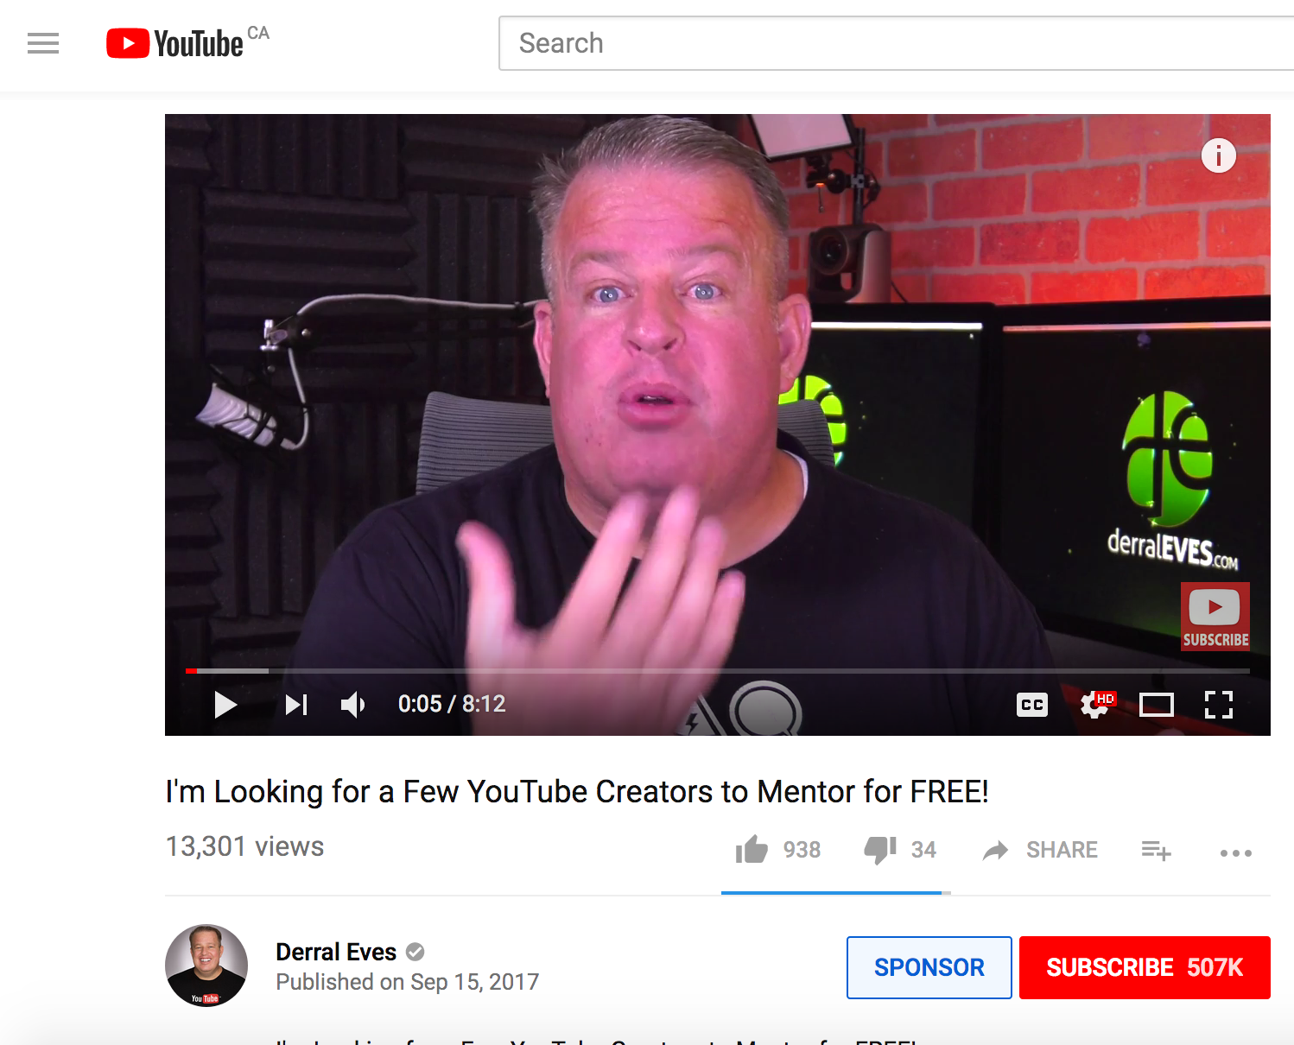
Example: YouTube as a website of Participatory Culture
Mentorship: Informal mentorship exists where knowledge is passed from more experienced group members to novices/newcomers.

Slide 14
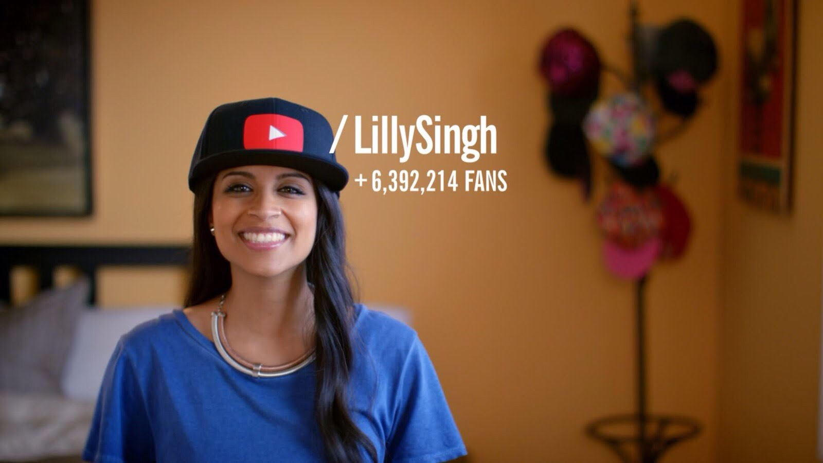
Example: YouTube as a form of Participatory Culture
What you make matters: Members believe their contributions to the group will be welcomed and respected by other community members.
Believe their content is of value, whether it entertains, educates, offers support/comfort, etc.
Notes:
Link in photo: https://www.youtube.com/watch?v=IgIRwx9YikY

Slide 15
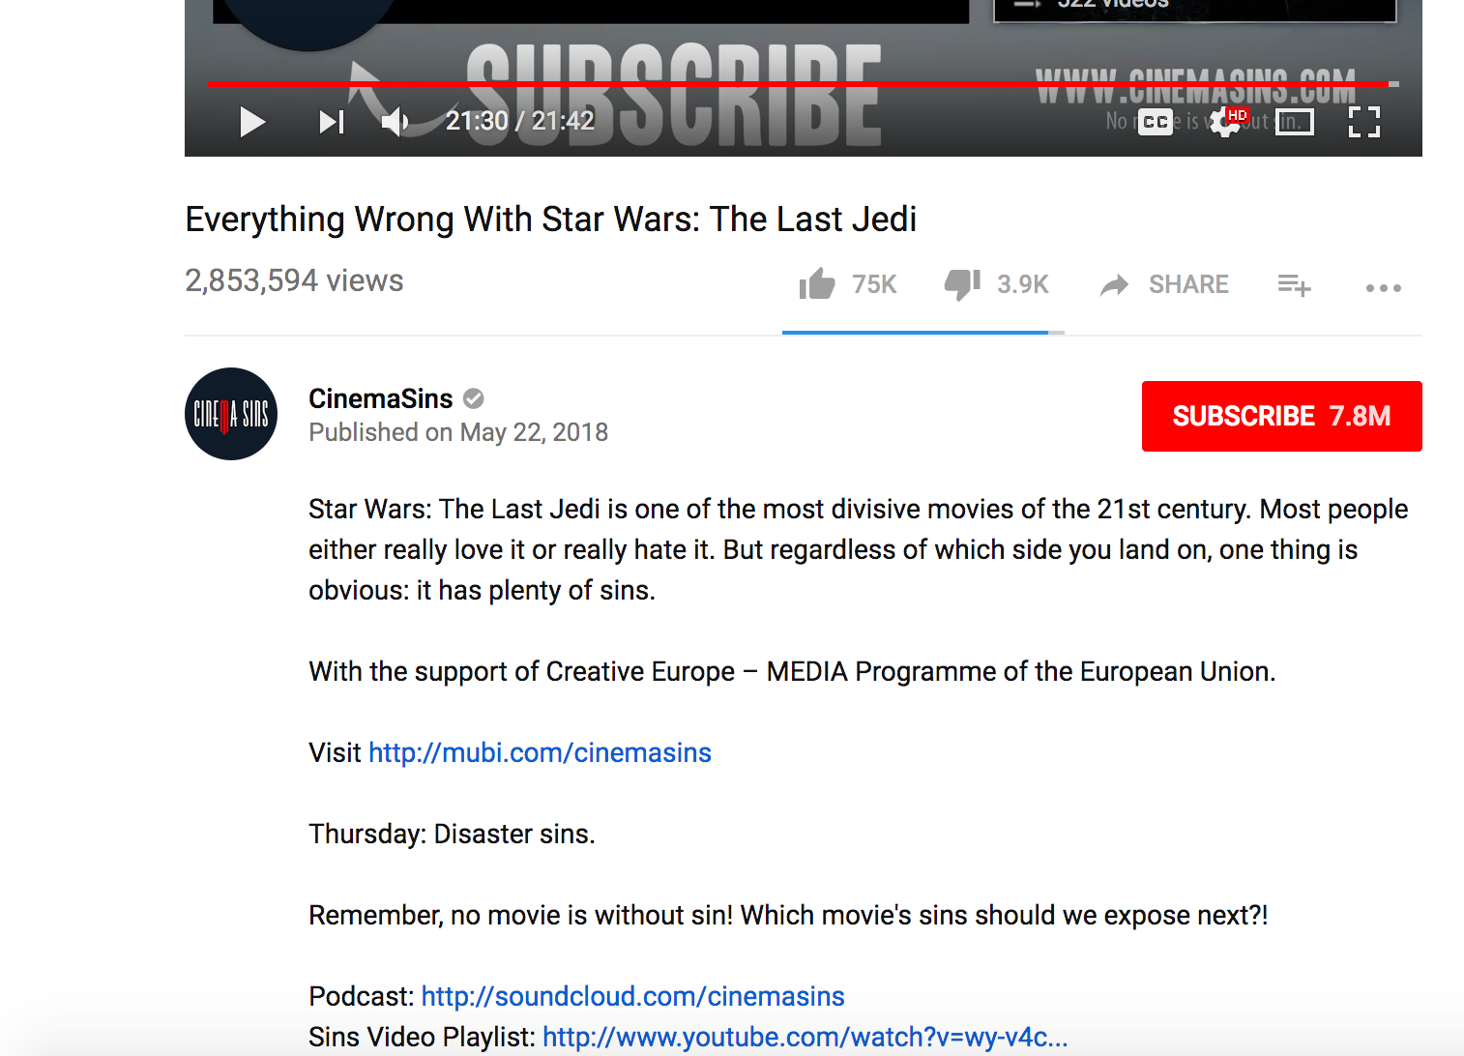
Example: YouTube as a website of Participatory Culture
Community matters: Members feel a degree of social connection with each other & care about what other community members think about their creations.
May ask for input on current content, ask for ‘likes’, to turn on notifications
May ask for suggestions for future content

Slide 16
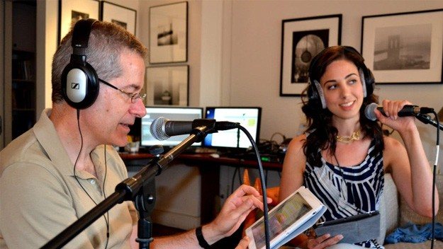
Participatory Culture
In our first lecture, you were introduced to the concept of “moral panics” and “technopanics” and how Sherry Turkle was concerned that social media might be leading to an overall decline in sociality.
Jenkins would disagree with this assessment. Instead, he argues that participatory culture has allowed consumers to take media into their own hands and tell their own stories. By sharing their creations online, they can make connections with likeminded individuals.

Slide 17
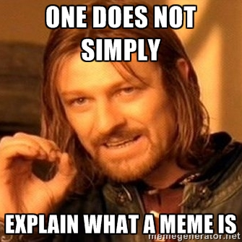
Internet Memes as a form of Participatory Culture
In the assigned reading for this Module, Kate Miltner discusses cat-themed Internet memes as both a cultural artifact, but also as a rallying point around which likeminded individuals can make connections.
But first, what are memes?
Evolutionary biologist Richard Dawkins in his 1976 book, The Selfish Gene, first coined the term “meme”. Meme became the word he used to describe the way an idea or piece of information can travel through society while mutating, changing, and shifting - much like a gene.

Slide 18
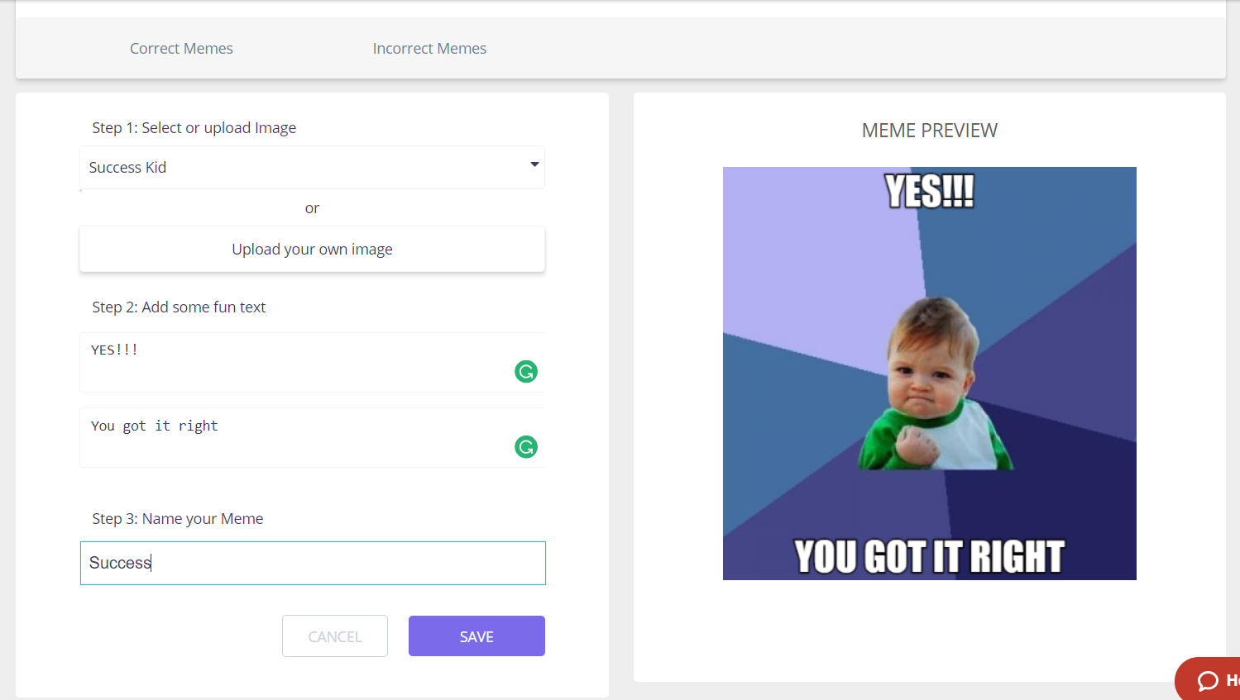
Internet Memes as a Form of Participatory Culture
This attempt to apply evolutionary theory to the shifting and ever changing aspects of a culture has since been taken up by scholars interested in the study of digital culture. The most commonly cited definition of internet memes can be found in Patrick Davison’s book chapter entitled “The Language of Internet Memes” describes them as follows: “An Internet meme is a piece of culture, typically a joke, which gains influence through online transmission” (p. 122).
“Internet memes” can take the form of images, videos, short pieces of text, or a website that are shared via computer-mediated communication, and like Dawkins’ memes, begin to modify as they are shared.

Slide 19

Internet Memes as a Form of Participatory Culture
One variety of meme you may have encountered prior to this course is a particular style of pictures known as an “image macro”.
Image Macro describes captioned images that typically consist of a picture and a witty message or a catchphrase.
Some common features of an image macro include:
  The image of a person or an animal.
  Text is overlaid, typically using impact font with white text.
  It must be easily replicated, with other users being able to swap out the existing text for their own
  The font used is ‘Impact’

Slide 20
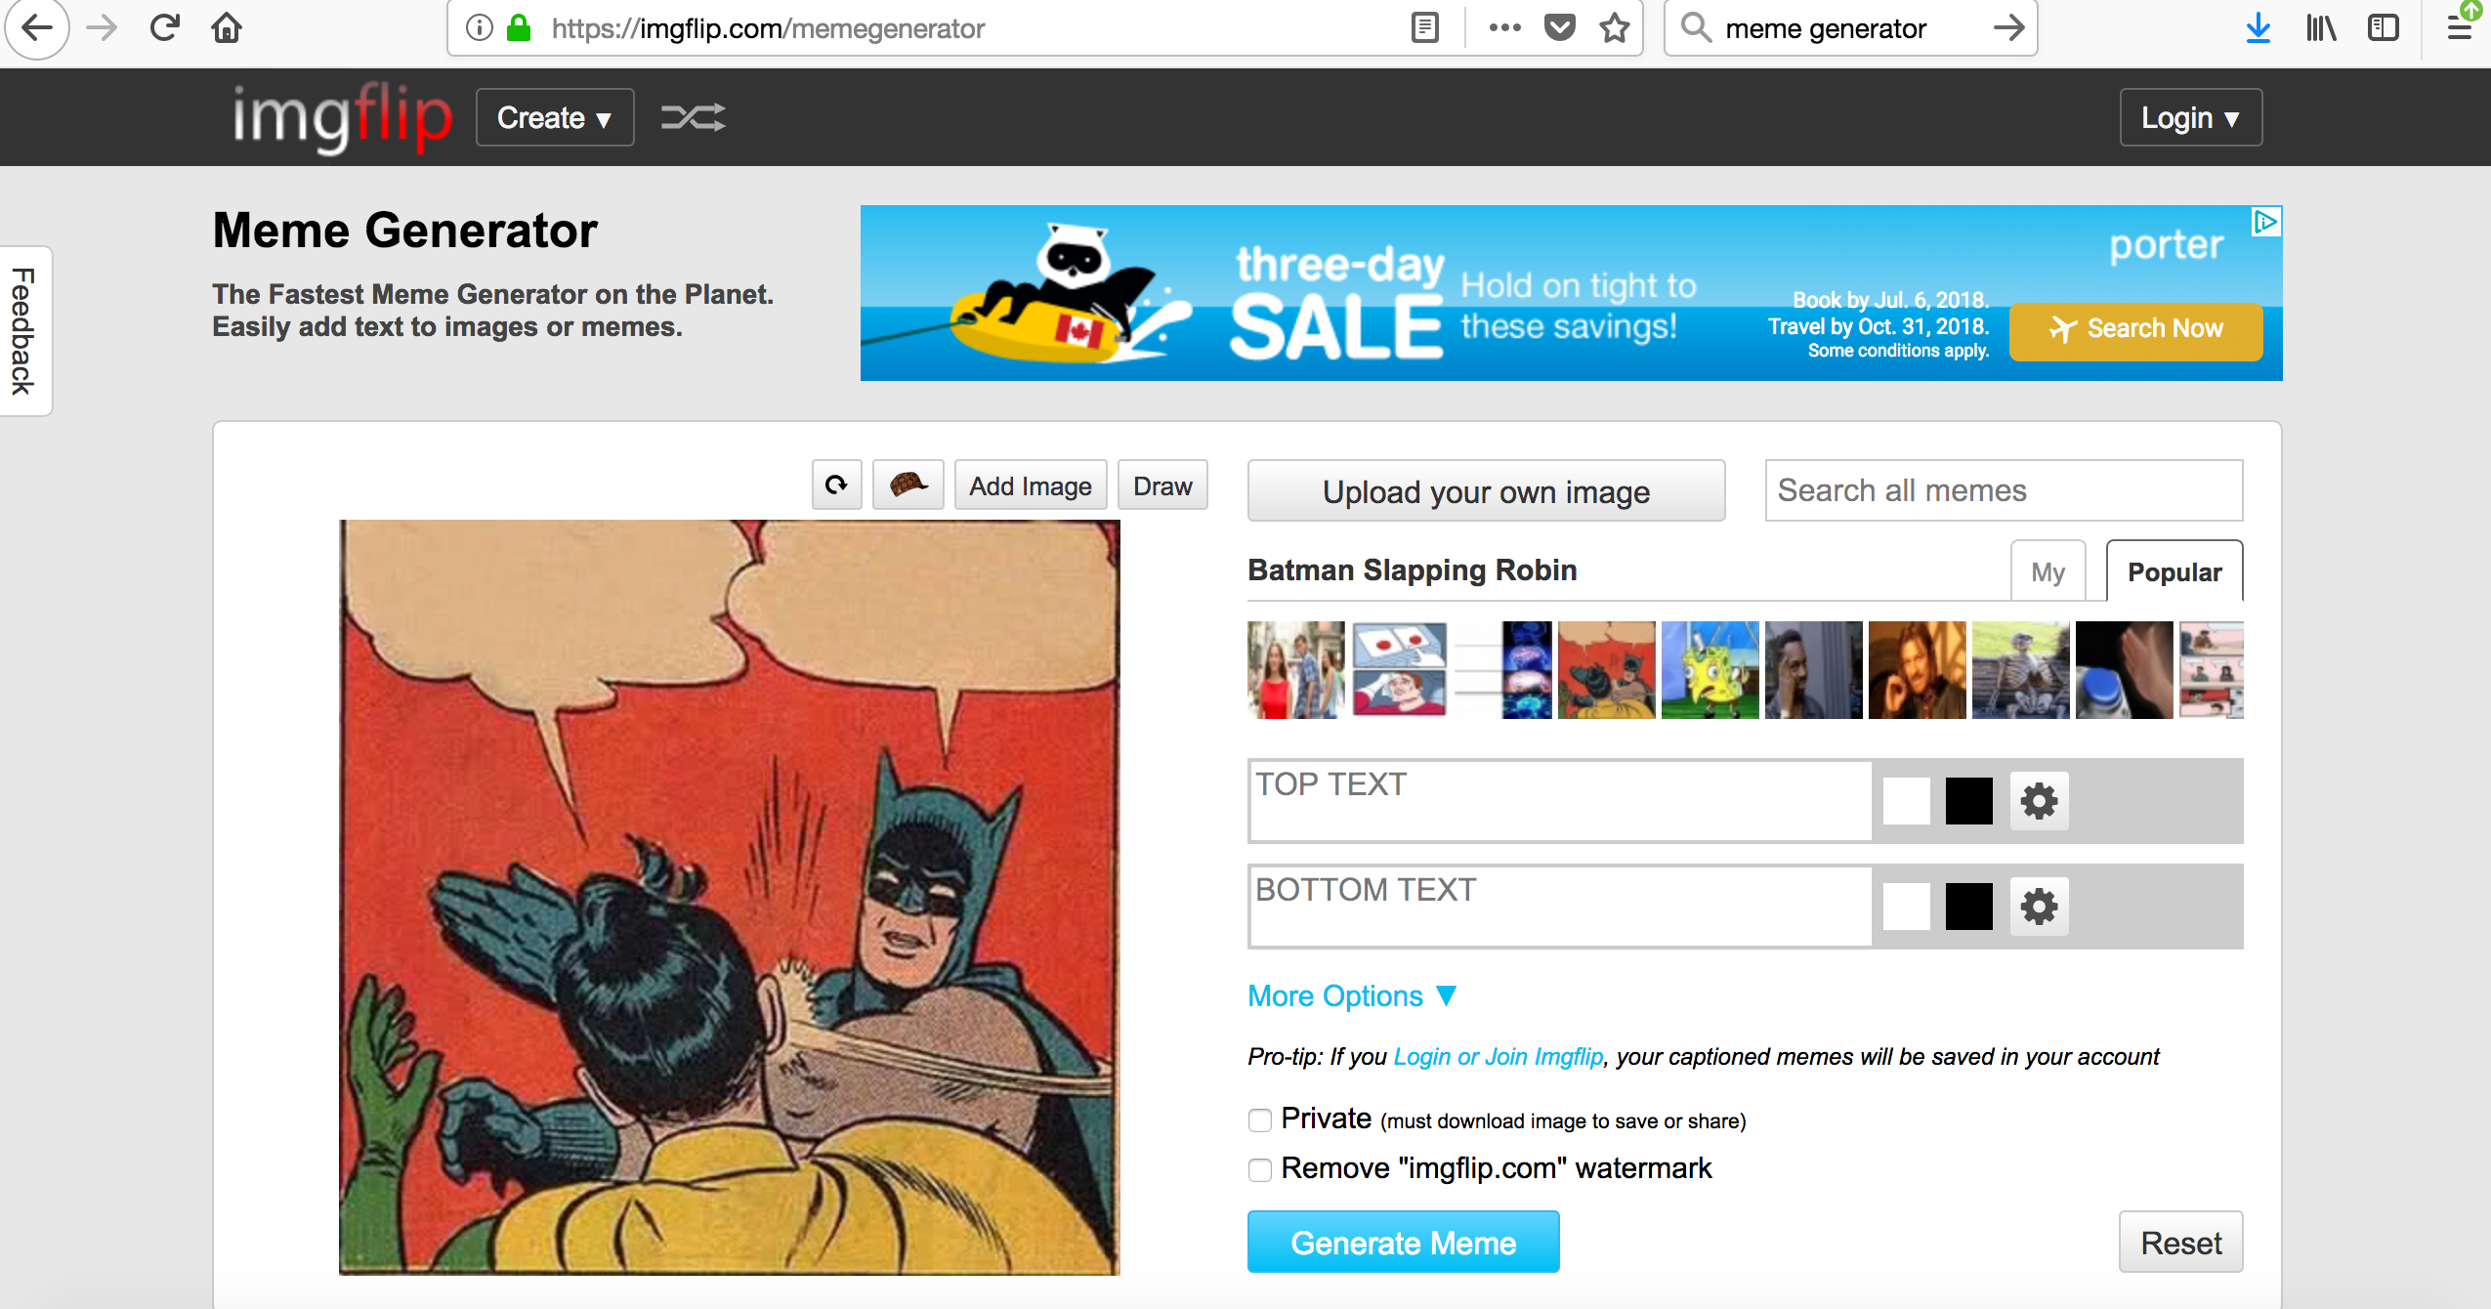
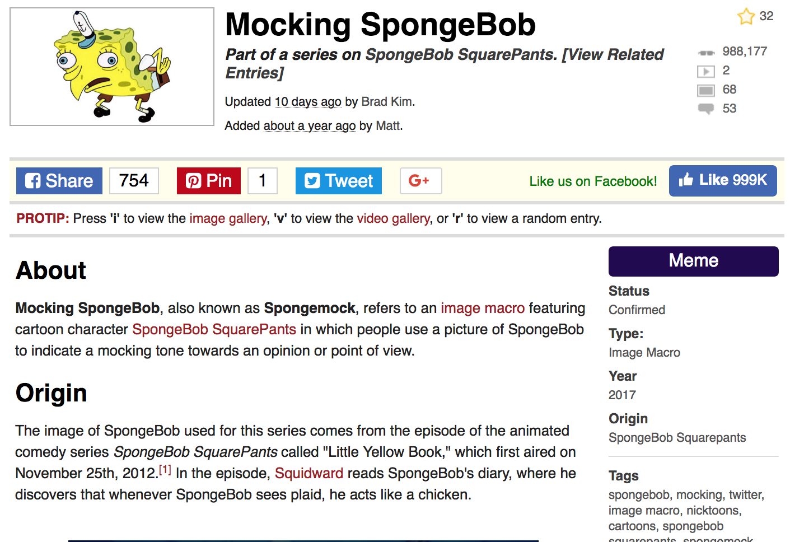
Internet Memes as a Form of Participatory Culture
Part of the reason that image macros have become so popular is because of how easily they can be spread. A new variation of an image macro might be made on one of the many websites that exist solely to create memes, or they be made on an individual’s computer using Photoshop or other image manipulation software and then uploaded to an image sharing site such as flickr.com or imgur.com. From there, a photo might be saved, and re-shared - each share taking it one step further away from the original author.
The reliance on stock photo and lack of attribution to any particular author are both problems when attempting to trace the history of a particular meme, however sites such as knowyourmeme.com use crowdsourcing to figure out the origin stories of popular image macros.

Slide 21
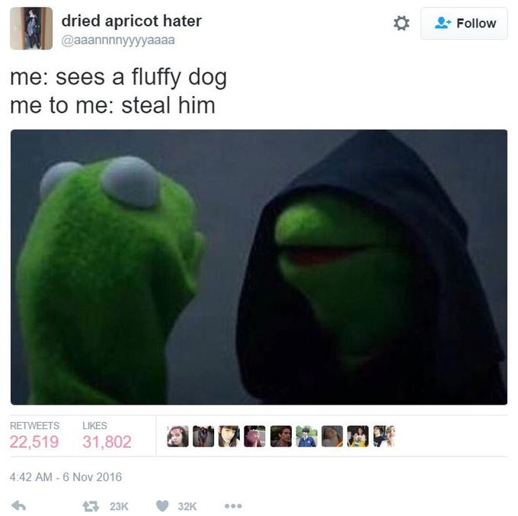
Internet Memes as a Form of Participatory Culture
One example of an author being identified comes from late 2016’s “Evil Kermit” meme. A columnist from The Verge was able to track down the first instance of the meme and ask the author about their intentions for creating it. Important here is how even though the first instance of the meme was almost instantly identified, Evil Kermit quickly took on a life of its own beyond the author’s original picture and text combination.
On November 6th, 2016, Twitter user @aaannnnyyyyaaaa^{[1]} tweeted a screenshot of Kermit the Frog standing next to a Sith version of himself with the caption "me: sees a fluffy dog / me to me: steal him" (shown below). Within 10 days, the tweet gained over 31,800 likes and 22,500 retweets.
Read more here: https://www.theverge.com/2016/11/17/13650972/evil-kermit-meme-twitter

Slide 22
Internet Memes as a Form of Participatory Culture
This is an important reminder is an important reminder that the person who posts a meme to their social networking page is not necessarily the person who originally created it. At this point the key lesson for your own social media practices is that if your plans are to create viral media, you may not necessarily be credited as its author if and when your creations do go viral.
Someone else may attempt to take credit for your meme and/or monetize it before you do. We will return to these issues surrounding monetization and labour.

Slide 23
Internet Memes as a Form of Participatory Culture
Also important to note is that the meanings behind certain memes can shift over time. For instance, there is the case of “Pepe the Frog” and how this particular meme has (rightly or not) become associated with the alt-right movement.
Consider the imagined audience (i.e. the mental conceptualization of the people with whom we are communicating). While you may post a meme that would be understood and appreciated by your school friends, thanks to the phenomenon of context collapse, it will might also be seen by family and co-workers.
For example, if you share a Pepe meme with your friends, they may know that you have been using the meme long before its current shift in meaning. However, a family member who has only been introduced to Pepe through coverage about its newer associations with the alt-right movement may interpret it as a signal that you hold particular beliefs. Whether or not you will share such content is another decision you will have to make as you craft your professional social media identity beyond this course.

Slide 24
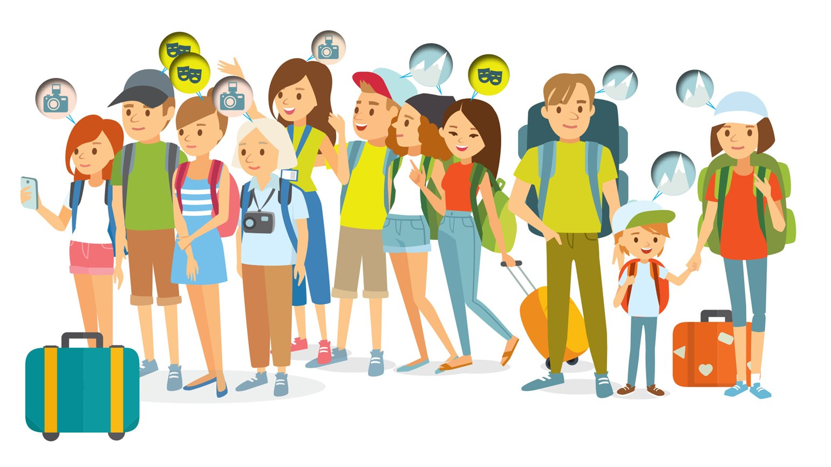
Affinity Groups
In the last lecture, you were introduced to the concept of homophily, that groups of likeminded people will tend to be attracted to each other. Sometimes this leads to a filter bubble, or an oversaturation of certain types of information at the expense of dissenting or alternative viewpoints.
Another way that likeminded people come together is by becoming part of an affinity group. This refers to a group of people who are brought together by a common interest in a particular activity or subject matter. Affinity groups share some degree of overlap with the third places we discussed previously, the space for interaction that exists outside one’s home and workspace. The primary difference here is that an affinity group can form in any of these venues, not just the third place.

Slide 25

Affinity Groups
Returning to the Kate Miltner reading, her research into LOLCats found that people who share and appreciate this particular form of meme tended to fall into one of three groups:
  The casual users who shared but rarely made their own.
  A group of people who associated this particular type of meme with nostalgia.
  A group of people heavily invested in the making and sharing of new LOLCat imagery.
This third group of users, the group that Miltner has dubbed the Cheezfrenz, represents an example of an affinity group that have been brought together via social media. Here she describes the use of a particular vernacular (lolspeak) but also a community that meets the Jenkins’ definitions of participatory culture discussed earlier in this Module.

Slide 26
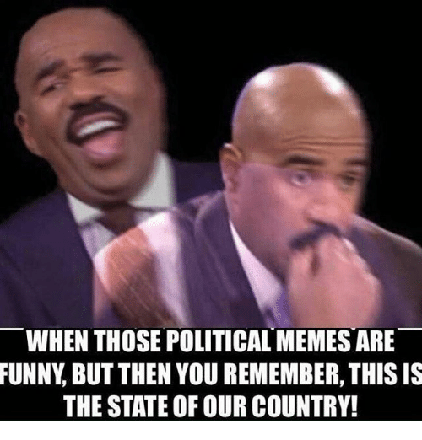
Affinity Groups
Thus far, the examples of memes you have been introduced to have focused on jokes or other amusing web content that is shared via social media, email, websites, or any other form of technology that allows us to communicate with each other.
However, research on memes has shown that customizing and sharing of image macros has become a key part of online political dialogue, such as sharing opinions about an upcoming election.
The proper usage of a particular meme can also be used as a way to signal to others that you are an insider or a member of a particular group - in the case of the Miltner article this would be a community’s member ability to speak “perfect LOL”.

Slide 27
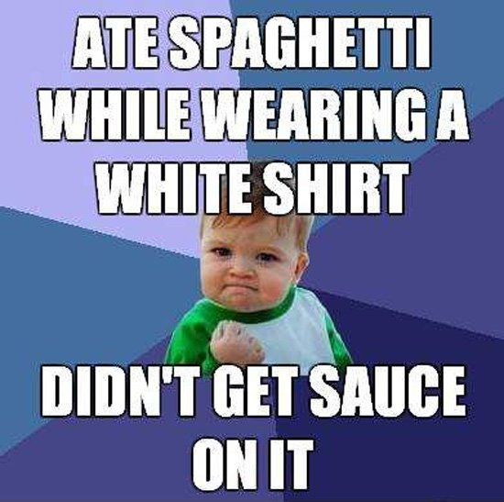
Affinity Groups
The ability to make memes that are legible to other users is a form of digital literacy. In her article deconstructing a meme that was popular in late 2009/early 2010, Whitney Phillips (whose work on Internet trolling was discussed in Identities Part II: Deception and Trolling) makes an important observation that image macros work tap into a shared cultural understanding:
  “Contrary to the assumption that memes hop arbitrarily from self-contained monad to self-contained monad, memes as they operate within trolldom exist in synecdochical relationship to the culture in which they inhere. In other words, memes spread-that is, they are actively engaged and/or remixed into existence-because something about a given image or phrase or video or whatever lines up with an already-established set of linguistic and cultural norms. In recognizing this connection, a troll is able to assert his or her cultural literacy and to bolster the scaffolding on which trolling as a whole is based, framing every act of reception as an act of cultural production.” (Phillips, 2013).

Slide 28
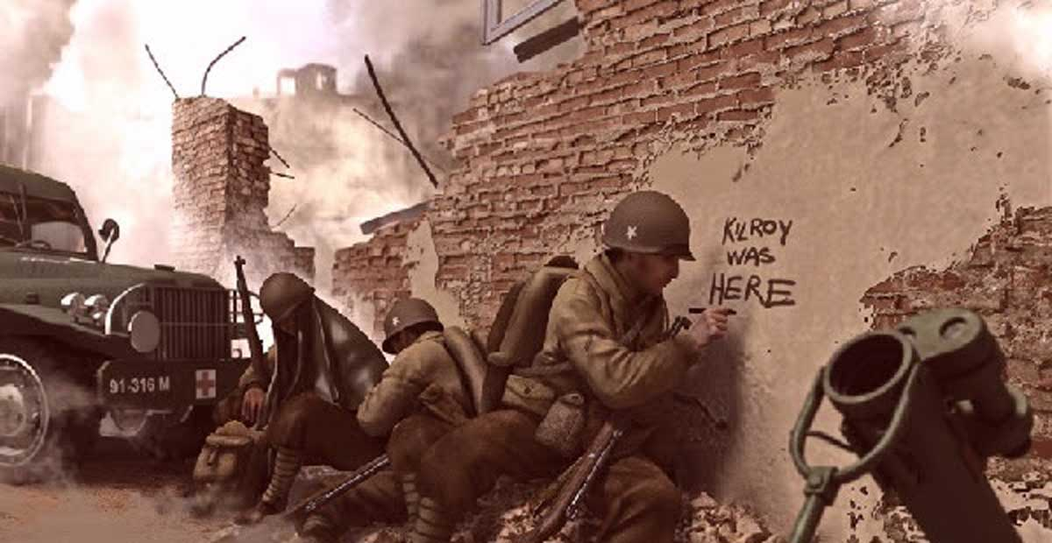
Affinity Groups
A final example of a meme being used to create a sense of community and belonging is “Kilroy was Here”, a text and image combination that pre-dates the internet. Soldiers fighting in World War II would graffiti this face and the phrase “Kilroy was here” all over the world.
Notes:
Link in photo: https://www.youtube.com/watch?v=AFw8MSF7yE4

Slide 29
Going Viral
A meme cannot become established unless it gains widespread attention, or “goes viral”
Something that “goes viral” is an image, video, text, or link that spreads rapidly through a population by being frequently shared with a number of individuals
Karine Nahon and Jeff Hemsley (2013) provide us with an efficient explanation for what virality is and what it constitutes:
  Virality is a social information flow process where many people simultaneously forward a specific information item, over a short period of time, within their social networks, and where the message spreads beyond their own social networks to different, often distant networks, resulting in a sharp acceleration in the number of people who are exposed to the message....virality is made on the bases of i) the human and social aspects of information sharing from one to another; ii) the speed of spread; iii) the reach in terms of the number of people exposed to the content; and iv) the reach in terms of the distance the information travels by bridging multiple networks. (16)
Notes:
Source: Nahon, Karine and Jeff Hemsley. Going Viral. Cambridge: Polity Press, 2013.

Slide 30
Going Viral
Nahon and Hemsley perceive virality itself as a complex process, comprised of top-down and bottom up forces that blur together to produce such a phenomenon
Network gatekeeping is a top-down force, stemming from the capacity for individuals to drive viral information flows through networks and deciding what content to present; bottom-up forces refers to the influence of individuals’ actions on whether or not something goes viral.
“No matter how much power gatekeepers have, virality is a social process that requires people to share content with each other. Gatekeepers can broadcast content, thereby linking networks, but unless some of the people who engage with the content find it remarkable enough to pass along to their friends, followers, and families, it isn’t a viral event.” (59)
Notes:
Source: Nahon, Karine and Jeff Hemsley. Going Viral. Cambridge: Polity Press, 2013.

Slide 31
Going Viral
Viral content is said to spread quickly through weak ties, as the item jumps from cluster to cluster, and once in a new cluster, strong ties influence to consume the content
An opinion leader increases the likelihood of something going viral, and, should a momentum be developed, the item can be featured on the relevant social media platform
Notes:
Source: Nahon, Karine and Jeff Hemsley. Going Viral. Cambridge: Polity Press, 2013.

Slide 32
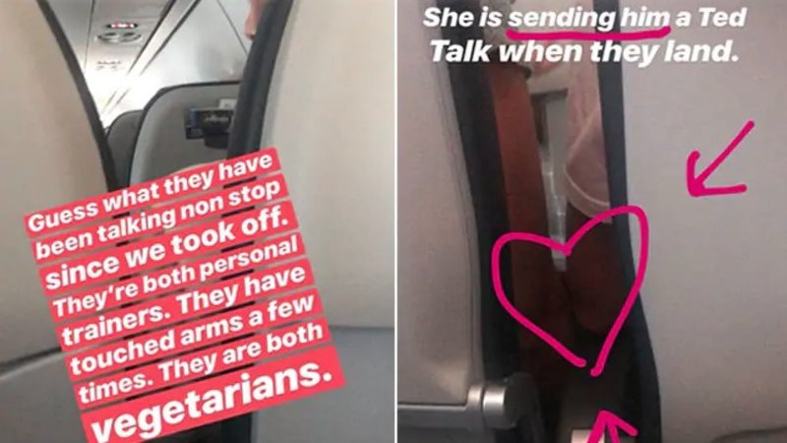
#PlaneBae (July 3rd, 2018)
Notes:
Was this thread cute? Or was it an invasion of the couple's privacy?
Should you expect someone to be broadcasting your life all the time, even when you're just talking to your seatmate on an airplane? Does merely witnessing sparks fly give someone the permission to broadcast them?
https://www.washingtonpost.com/news/soloish/wp/2018/07/05/the-real-stars-of-the-planebae-love-story-not-the-couple-but-the-voyeurs/?noredirect=on&utm_term=.ffd76d3ab3a0

Slide 33
#PlaneBae (July 3rd, 2018)

Slide 34
#PlaneBae (July 3rd, 2018)
Would you want your photo, video, Twitter thread, etc. to go viral like #PlaneBae? Why?
What do you think might be the advantages of having your content go viral? What might be the downside?
What do you think will happen with Rosey Blair, the comedian who posted the thread? What about Euan Holden and Helen? Will this viral thread lead to more opportunities than just 15 minutes of fame? Or, do you think all three will go back to a normal life, just with a lot more Twitter followers?

Slide 35
Lecture 8: Community – Internet Cultures
The goal of this Module has been to illustrate that Internet memes – while often funny or humorous – are not merely silly pictures. In this module we have explored:
Participatory culture, both its definition and how it breaks from the features associated with consumer culture.
The relationship between dialogic communication and participatory culture.
How creating memes can be a means to demonstrating one’s belonging to a particular community or group.
LOLCats as an example of an affinity group.
What it means to go viral

Slide 36
For next week:
Next week’s class (July 19th) will be in-class!
Lecture topic will be Social Media and Civic Engagement - material will be made available online and must be read before class
Ensure you post one tweet and two replies on Twitter before our next meeting on the topic of Internet Cultures

